Slide 1

TIC TAC TOE
Group Members:
Maheen Habib (F24CC024)
Rida Saleem (F24CSC007)
Sani-e-Zehra (F24CSC030)
Faculty Name:
Sir Bilal Ahmed
Computer Networks
Department of Computer Science
Faculty of Information and Technology

Slide 2


Overview
Introduction /Background
Motivation
Problem Statement
Scope of the Project
Project Objectives
Literature Review/Research Gap
Methodology/Framework
Tools and Languages
Gantt Chart
Conclusion
References
Division of role

Slide 3
Introduction/Background
Tic Tac Toe is a classic two-player game often used to demonstrate fundamental programming concepts. In this project, we have implemented a console-based version of the game in Java using object-oriented programming principles. The game allows two players to take turns, track their moves, and determine the winner or declare a draw.

Slide 4
Motivation
The motivation behind choosing Tic Tac Toe was to apply our understanding of core programming topics like loops, conditionals, arrays, functions, and data structures.
It serves as a simple yet powerful way to learn algorithm design, input validation, and turn-based logic, which are crucial for larger software projects.

Slide 5
Problem Statement
Most beginner-level games often lack scalability, proper code structure, and reusability. Our aim was to develop a clean, modular, and extensible version of Tic Tac Toe that includes features such as:
-Turn tracking using queues
- Move history
-Replay and undo support using stacks and lists

Slide 6
Scope of Project
The project covers:
- A fully functional two-player Tic Tac Toe game
- CLI-based interaction using Java
- Use of OOP principles like abstraction and inheritance
- Data structures: Stack, Queue, LinkedList, and ArrayList
- Clean user input handling and validation
- The project does not cover AI-based opponents or GUI elements.

Slide 7
Project Objectives
Implement an interactive two-player Tic Tac Toe game.
Apply object-oriented programming using Java.
Use built-in data structures for efficient game state management.
Ensure modular, maintainable, and reusable code.
Strengthen debugging, logic-building, and testing skills.

Slide 8
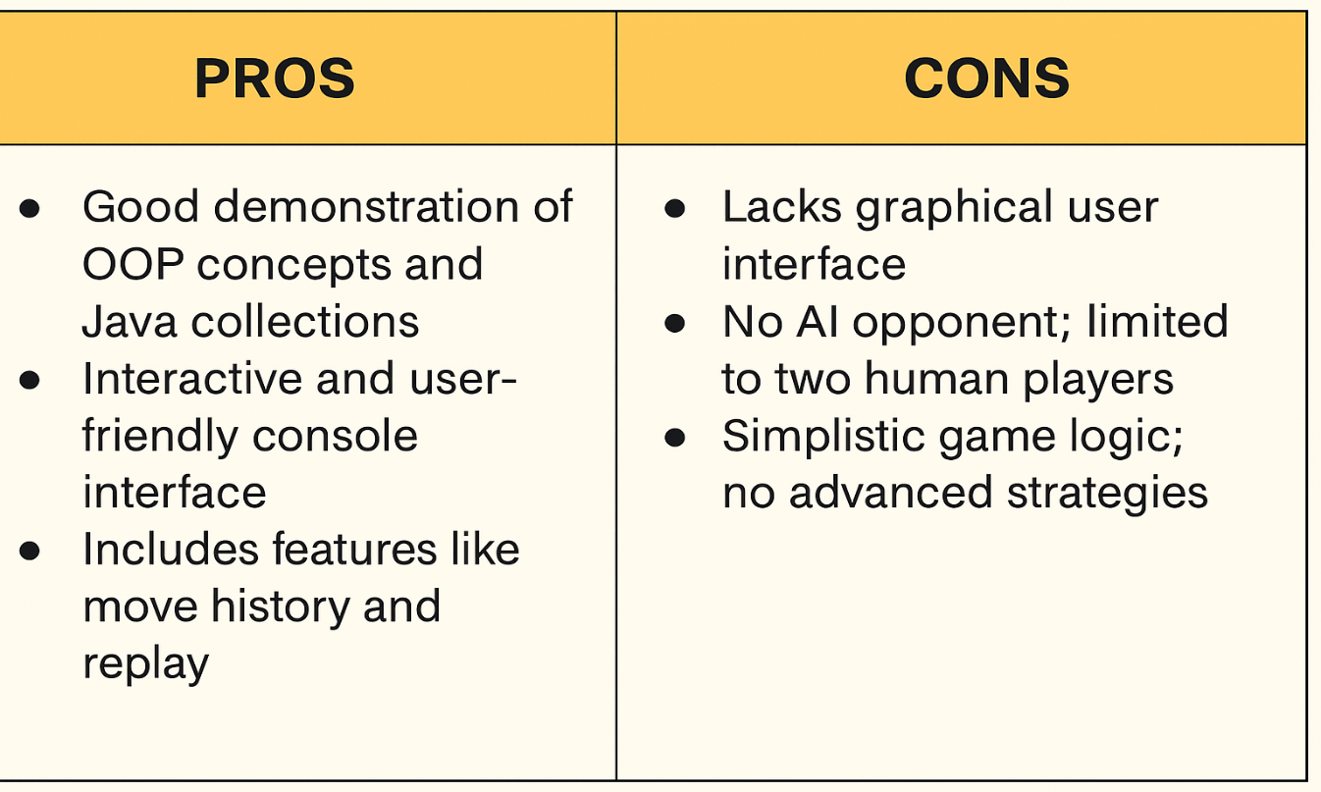
Literature Review/Research Gap

Slide 9
Methodology/Framework
Step 1: Design game logic and win conditions
Step 2: Define abstract Player class and implement HumanPlayer
Step 3: Use Queue to alternate turns, Stack for undo, and ArrayList for move history
Step 4: Validate user input and manage game flow
Step 5: Test and refine logic for edge cases like invalid input or replay

Slide 10
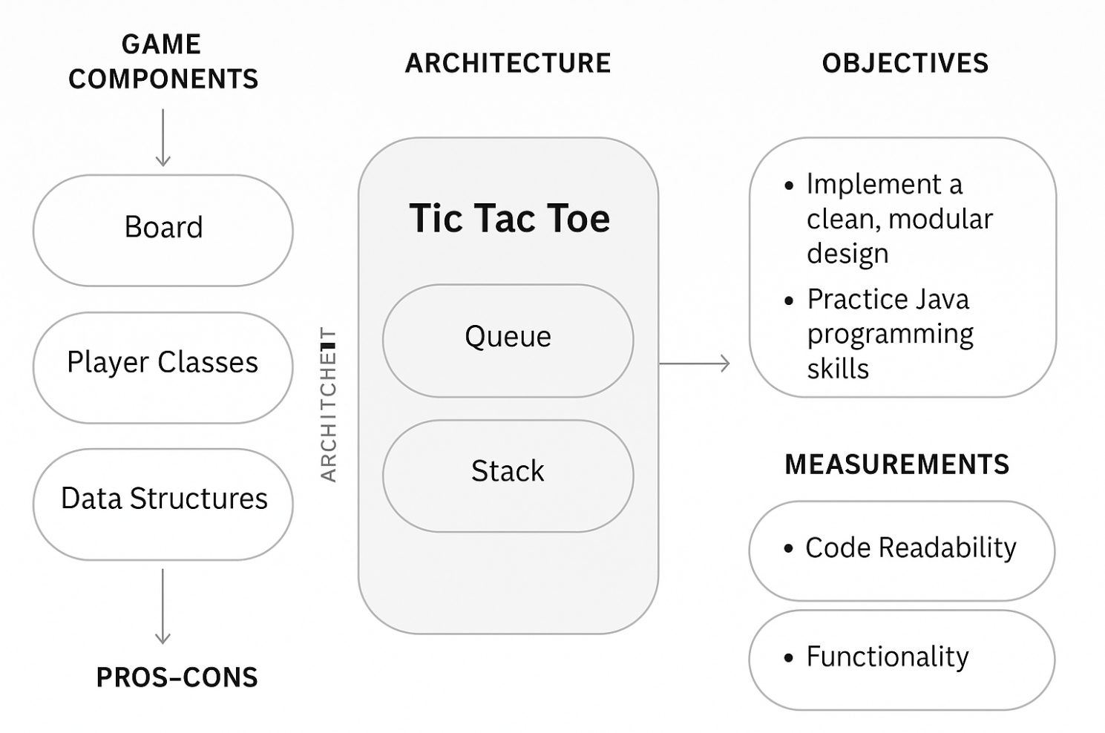
Methodology/Framework

Slide 11
Tools and Languages
Language: Java
IDE: Eclipse
Version Control: Git
Java Collections Used: ArrayList, LinkedList, Queue, Stack
OS Compatibility: Cross-platform (runs in any terminal with JDK)

Slide 12
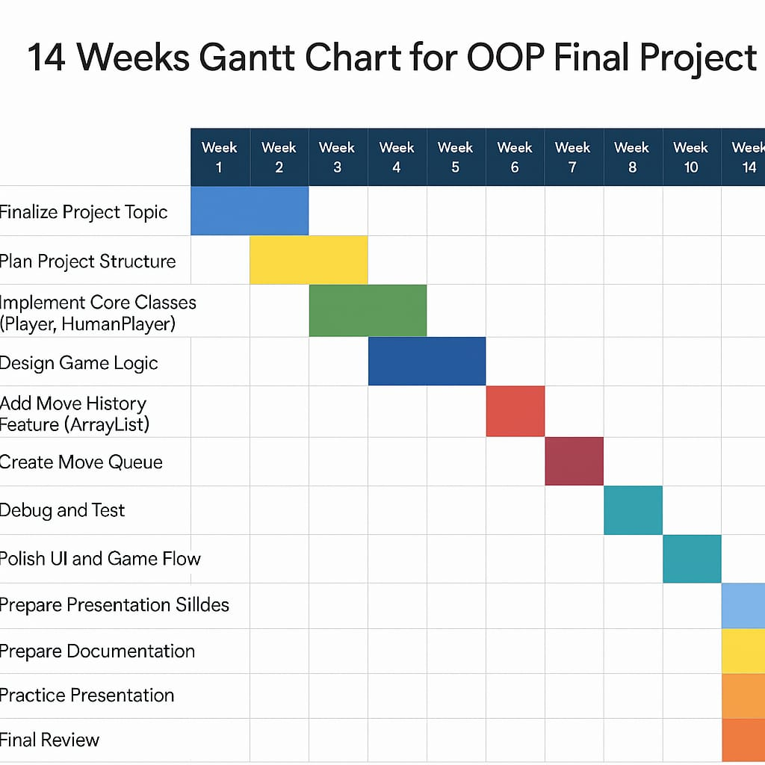
Gantt Chart

Slide 13
Conclusion
This project was a practical application of our 2nd-semester programming concepts in Java. It helped us understand how to structure real-world software using clean coding techniques and reinforced how data structures like stacks and queues can be applied beyond theory. The game is easily extendable for future enhancements like AI or GUI.

Slide 14

References
YouTube Tutorial: "Java Tic Tac Toe Game" Available at: https://youtu.be/WRr2h_R0AFM?si=RZfJ5Oo46MqU-8nG

Slide 15
Division of Role
Here you have to describe the role of each group members:
Team Member | Responsibilities
Maheen Habib | Plan the project, divide tasks, and manage integration.
Rida Saleem | Develop core logic and implement OOP concepts.
Sani-e-Zehra | Handle file operations, data structures and exception handling.

Slide 16
Q/A Session

